Slide 1
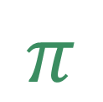
Chapter 4: Multivariate Normal Distribution
Applied Multivariate Statistical Analysis
6th edition by Johnson & Wichern
$$π$$
Gabrielle Salamanca

Slide 2

Overview
$$π$$
Objectives
4.6: Assessing the Assumption of Normality
Evaluating the Normality of the Univariate Marginal Distributions
Evaluating Bivariate Normality
4.7: Detecting Outliers & Cleaning Data
4.8: Transformations to Near Normality

Slide 3

Objectives
$$π$$
Ch 4.6
How to evaluate normality
Visually
Mathematically
Ch 4.7
How to detect outliers
Visually
Mathematically
Ch 4.8
Understand why we would transform the data
How to transform the data

Slide 4
Assessing the Assumption of Normality
1
Chapter 4, Section 6

Slide 5

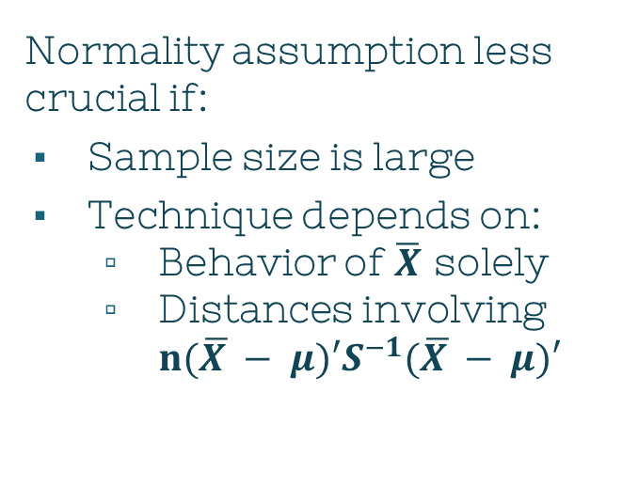
Normality & Techniques
$$π$$
Most techniques assume
Each $\vec{X_{j}}\sim 𝓝(μ,Σ)$
Normality assumption less crucial if:
Sample size is large
Technique depends on:
Behavior of $\overline{X}$ solely
Distances involving $n(\overline{X }− μ)′S^{−1}(\overline{X }− μ)′$
Notes:
In previous chapters, most of the statistical techniques discussed in previous chapters assume that each vector observation Xj comes from a MVN distr. However, that normality assumption isn’t as important if the sample size is large and the techniques solely depend on Xbar matrix’s behavior or distances involving that matrix of the form n(Xbar - mu)’S-1(Xbar – mu)

Slide 6
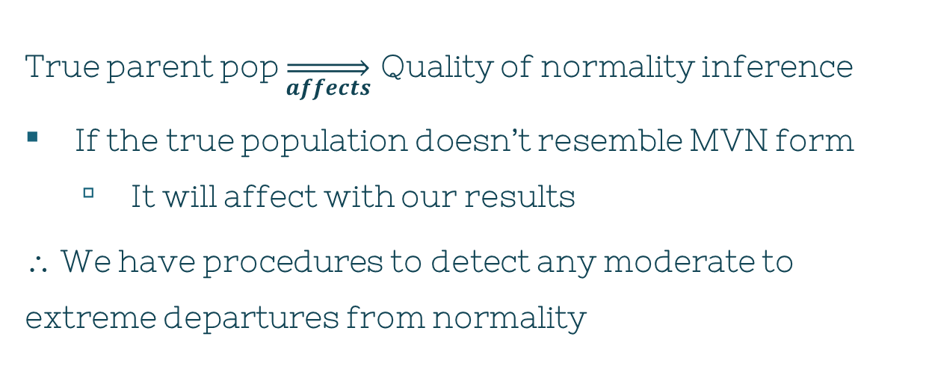
Normality & Techniques
$$π$$
True parent pop $\overset{⇒}{affects}$ Quality of normality inference
If the true population doesn’t resemble MVN form
It will affect with our results
∴ We have procedures to detect any moderate to extreme departures from normality

Slide 7
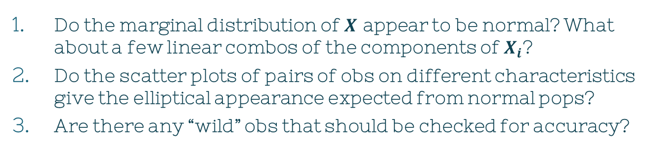
Normality Questions
$$π$$
Do the observations $\vec{X_{j}}$ appear to violate the normality assumption?
Do the marginal distribution of $X$ appear to be normal? What about a few linear combos of the components of $X_{i}$?
Do the scatter plots of pairs of obs on different characteristics give the elliptical appearance expected from normal pops?
Are there any “wild” obs that should be checked for accuracy?

Slide 8
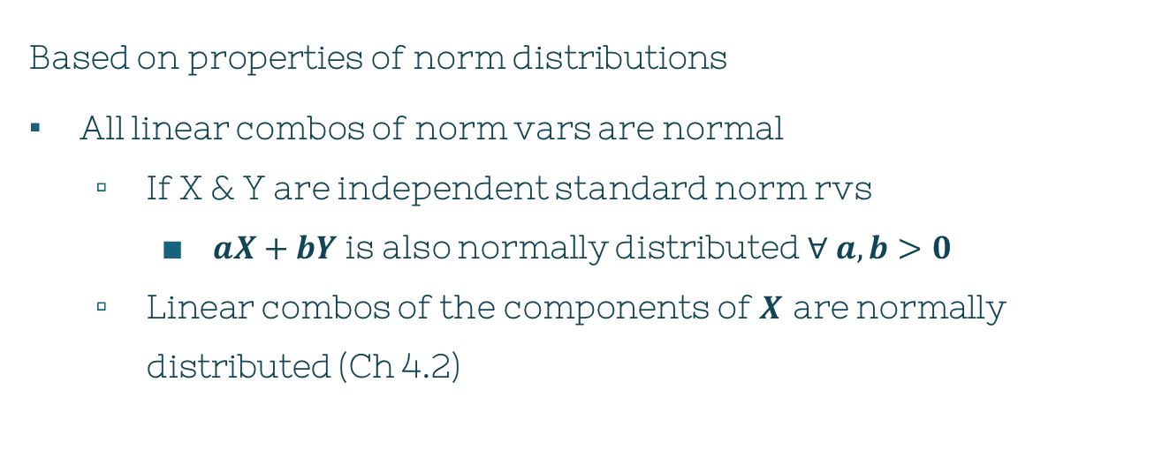
Normality Questions
$$π$$
Based on properties of norm distributions
All linear combos of norm vars are normal
If X & Y are independent standard norm rvs
$aX+bY$ is also normally distributed $∀ a,b>0$
Linear combos of the components of $X$ are normally distributed (Ch 4.2)

Slide 9
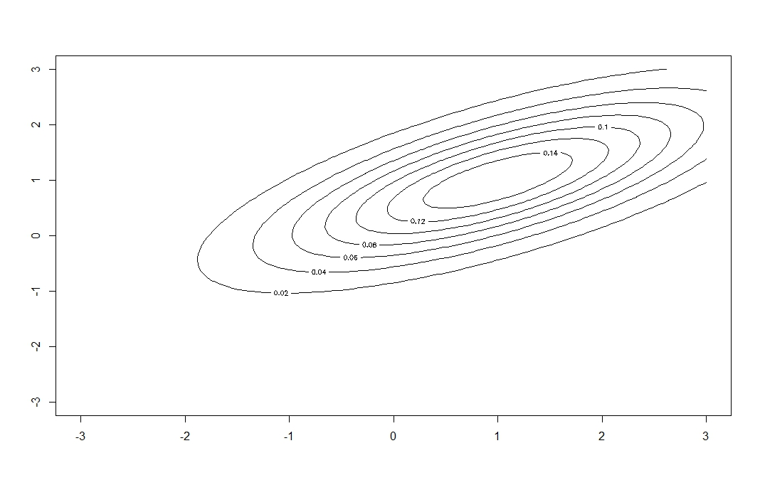
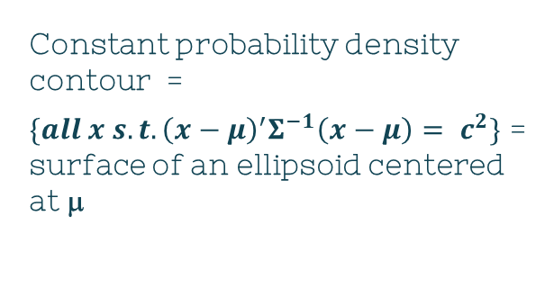
Normality Questions
$$π$$
Based on properties of norm distributions
Contours of MVN density are ellipsoids (Ch 4.2)
Constant probability density contour =
$\{all x s.t. {\left(x−μ\right)}^{′}Σ^{−1}\left(x−μ\right)= c^{2}\}$ = surface of an ellipsoid centered at μ

Slide 10
Heads Up
Investigations of normality
Mainly concentrating in 1D or 2D
Consequence:
Can’t guarantee we’ll catch every little feature that’s revealed only in higher dimensions

Slide 11
Univariate Evaluation
$$π$$
1. Visually
Dot diagrams
Histograms
Q-Q plots
2. Mathematically
Area under the curve of a normal distribution

Slide 12
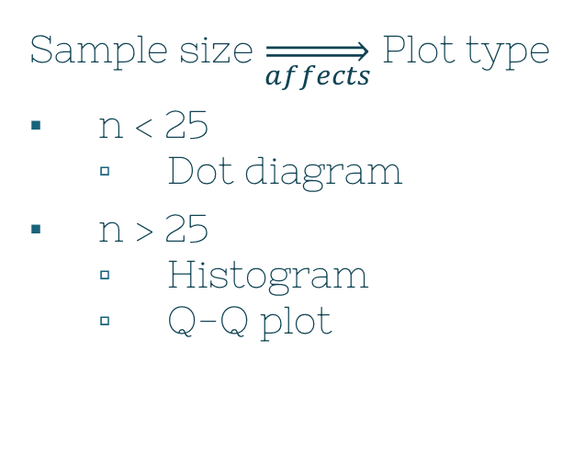
Univariate Evaluation
$$π$$
Sample size $\overset{⇒}{affects}$ Plot type
n < 25
Dot diagram
n > 25
Histogram
Q-Q plot
Check if the distribution is skewed
If it appears symmetric
then calculations are in order

Slide 13
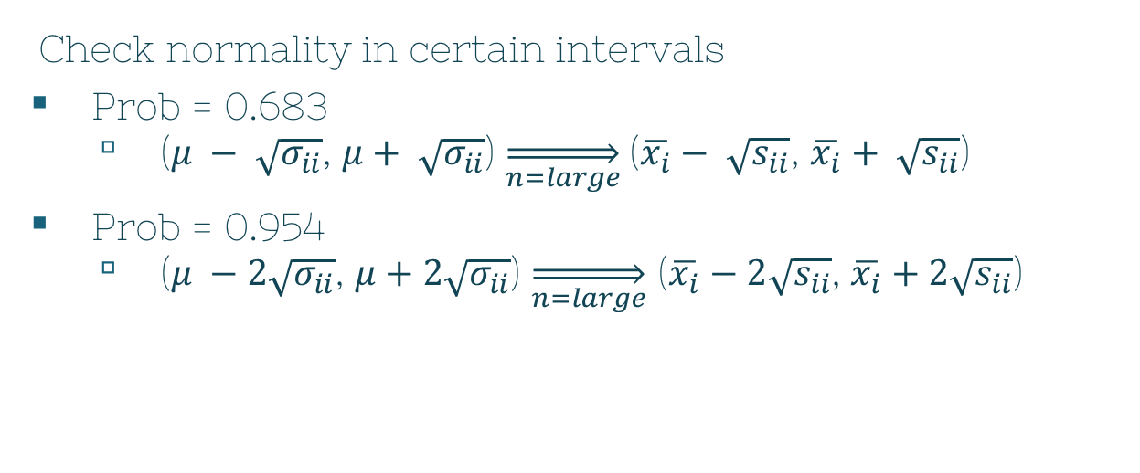
Univariate Evaluation
$$π$$
Check normality in certain intervals
Prob = 0.683
($μ − \sqrt{σ_{ii}}$, $μ+ \sqrt{σ_{ii}}$) $\overset{⇒}{n=large}$($\overline{x_{i}}− \sqrt{s_{ii}}$, $\overline{x_{i}}+ \sqrt{s_{ii}}$)
Prob = 0.954
($μ −2\sqrt{σ_{ii}}$, $μ+2\sqrt{σ_{ii}}$) $\overset{⇒}{n=large}$ ($\overline{x_{i}}−2\sqrt{s_{ii}}$, $\overline{x_{i}}+2\sqrt{s_{ii}}$)

Slide 14
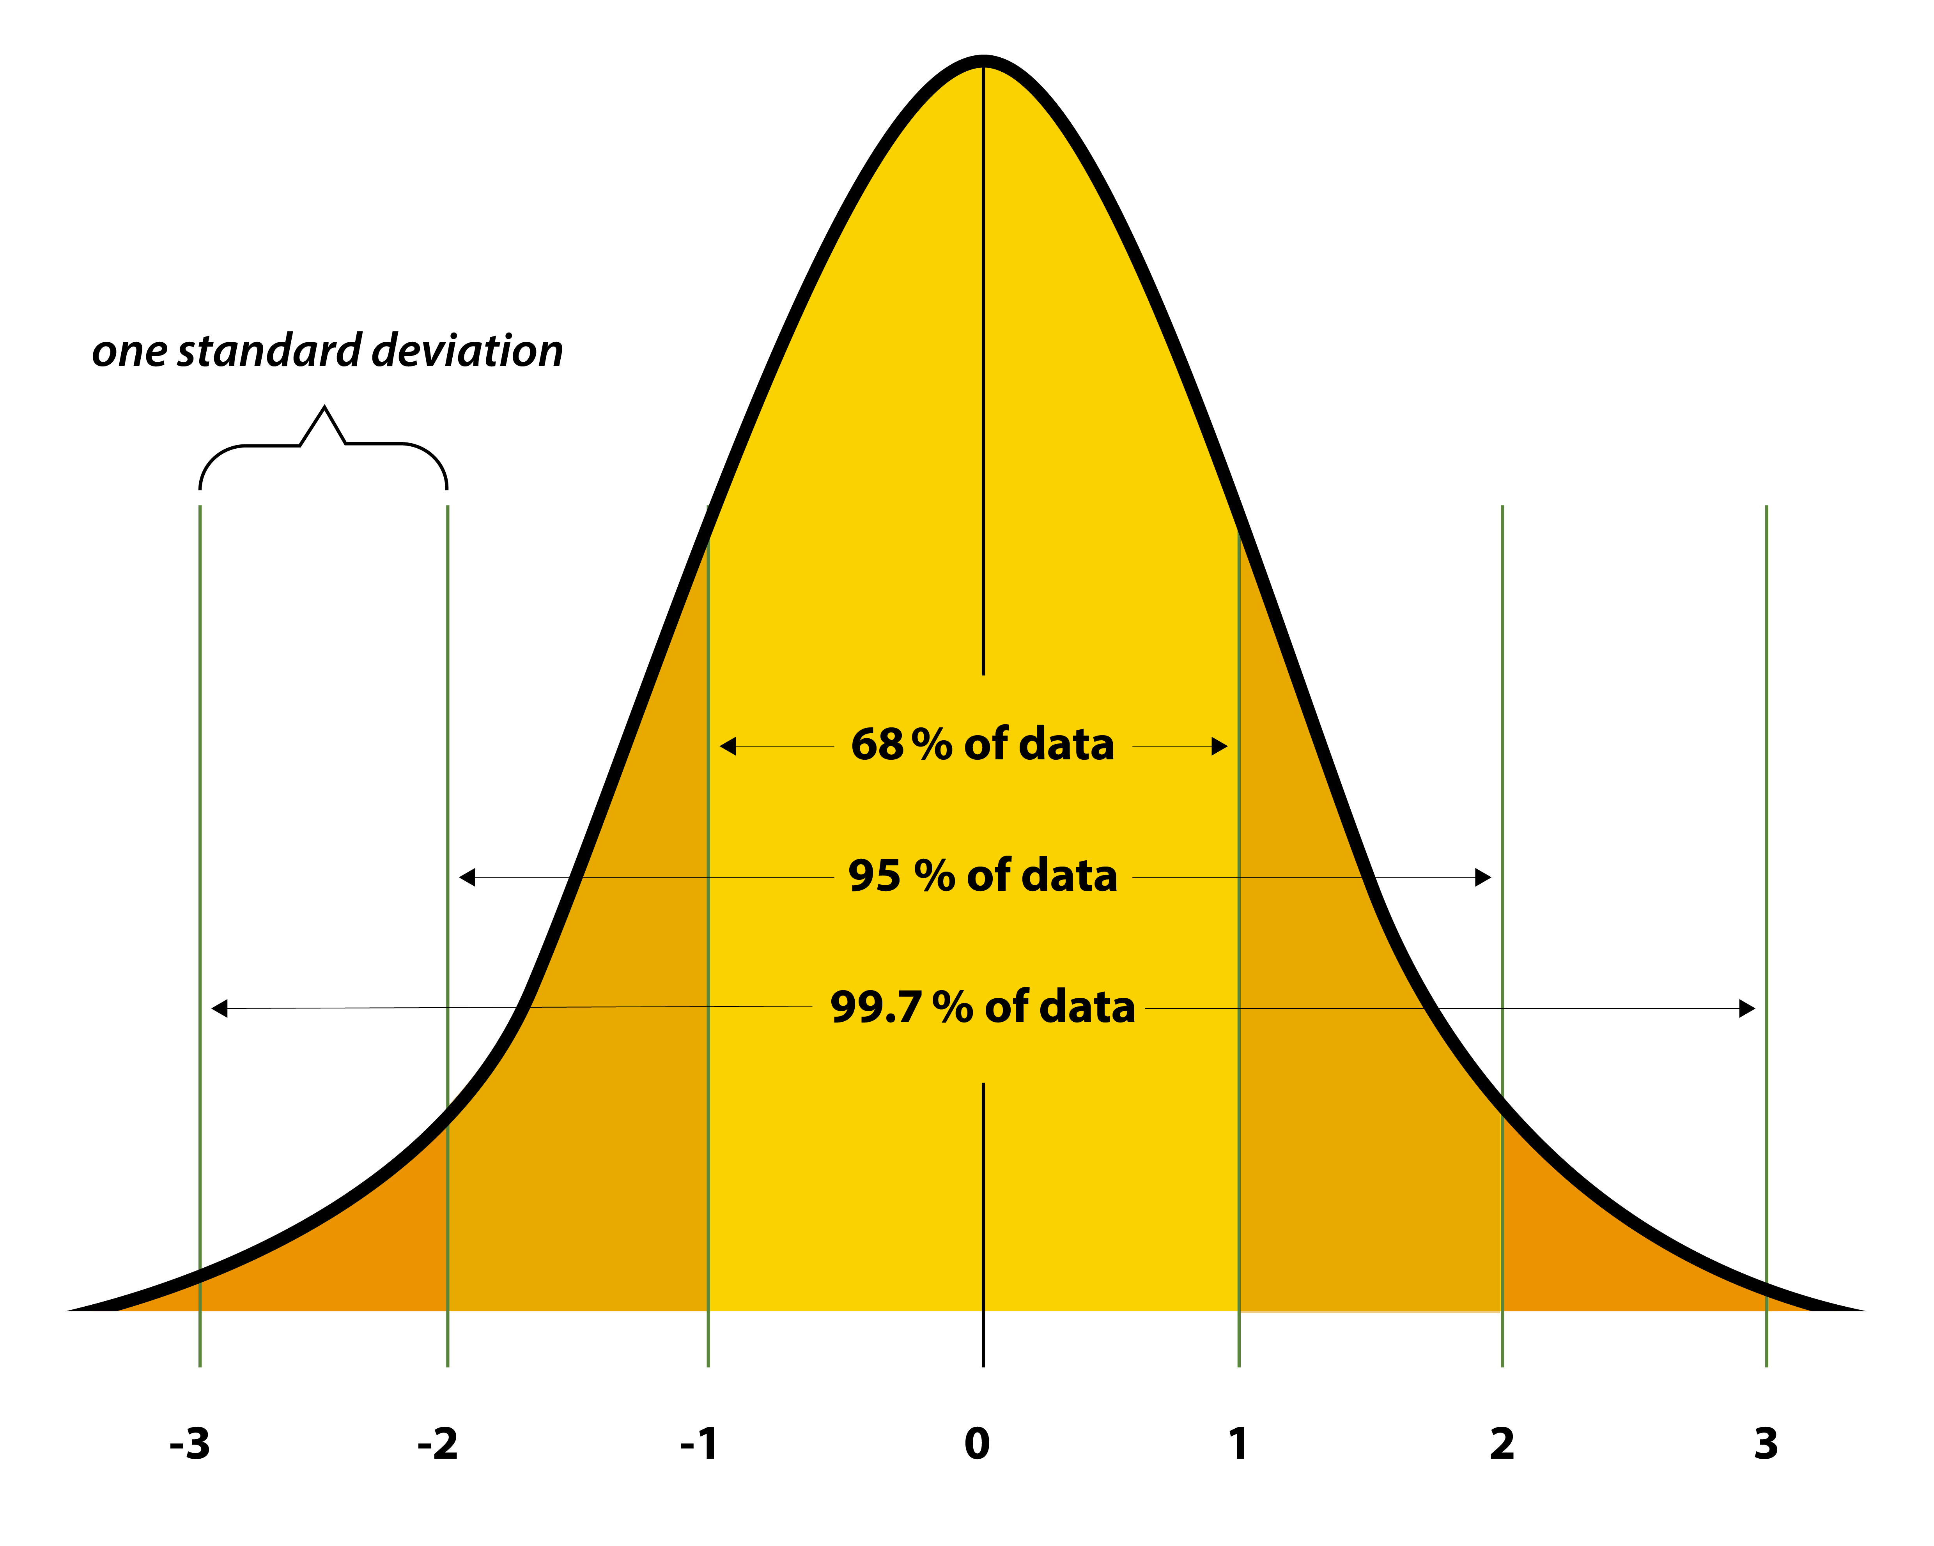
Image: Standard normal distribution curve." Sampling Distributions for Counts and Proportions.
University of North Carolina, Freeman and Company. 2009.

Slide 15
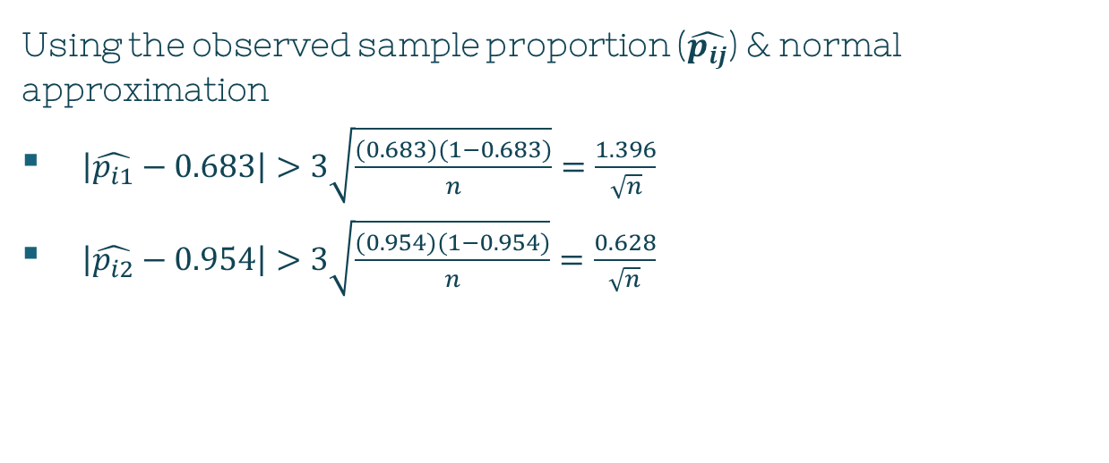
Univariate Evaluation
$$π$$
Using the observed sample proportion ($\hat{p_{ij}}$) & normal approximation
$\left|\hat{p_{i1}}−0.683\right|>3\sqrt{\frac{(0.683)(1−0.683)}{n}}=\frac{1.396}{\sqrt{n}}$
$\left|\hat{p_{i2}}−0.954\right|>3\sqrt{\frac{(0.954)(1−0.954)}{n}}=\frac{0.628}{\sqrt{n}}$
Notes:
We expect the observed proportion p-hat of observations lying on the interval to be about 0.683/0.954
If the observed props are too small, the parent distr with thicker tails than normal are suggested

Slide 16
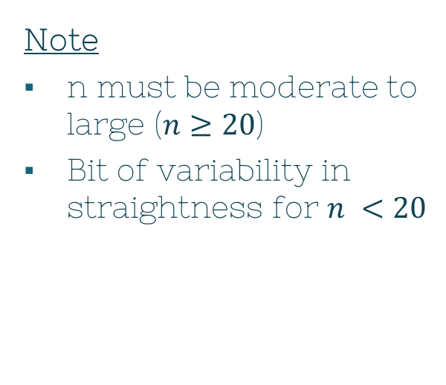
Univariate Evaluation: QQ plot
$$π$$
Q-Q (quantile-quantile) plot
Another way to assess if the obs came from MVN
Two sets of quantiles/percentiles of the data plotted on a scatter plot
If it forms a roughly straight line
⇒ normality assumption holds
Note
n must be moderate to large ($n≥20$)
Bit of variability in straightness for $n <20$
Notes:
We expect the observed proportion p-hat of observations lying on the interval to be about 0.683/0.954
If the observed props are too small, the parent distr with thicker tails than normal are suiggested

Slide 17
Univariate Evaluation: QQ plot
$$π$$
Q-Q (quantile-quantile) plot
Can also provide clues about the nature of non-normality
Pattern of deviations
There are ways to handle non-normal data
More in Ch 4.8!
Notes:
We expect the observed proportion p-hat of observations lying on the interval to be about 0.683/0.954
If the observed props are too small, the parent distr with thicker tails than normal are suiggested

Slide 18
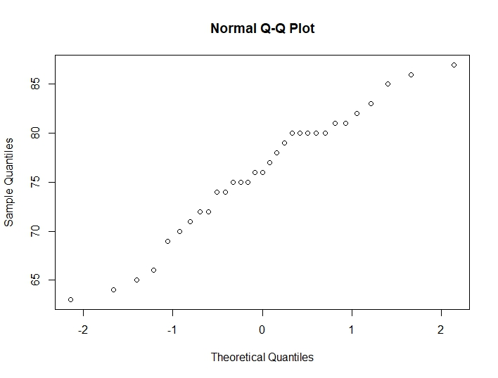
Univariate Evaluation: QQ plot
$$π$$
Q-Q (quantile-quantile) plot
trees dataset in R
31 observations
3 columns
qqnorm(trees$Height)
Relatively straight
Notes:
We expect the observed proportion p-hat of observations lying on the interval to be about 0.683/0.954
If the observed props are too small, the parent distr with thicker tails than normal are suiggested

Slide 19
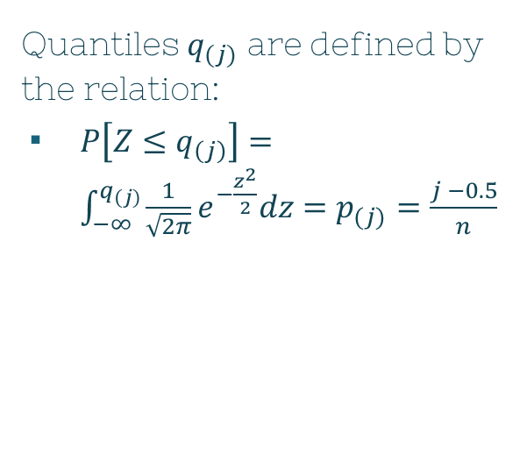
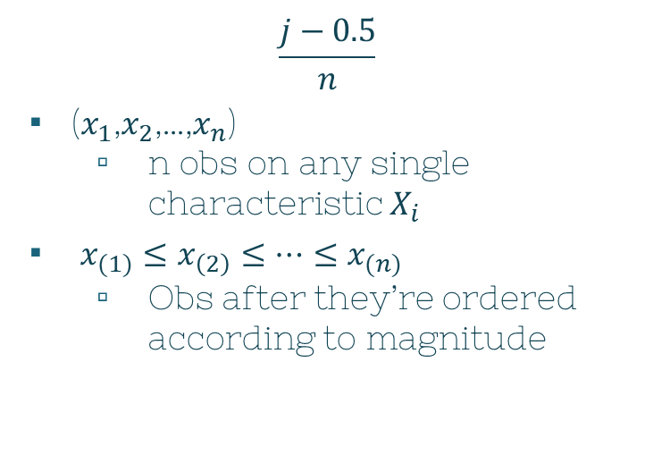
Univariate Evaluation: Histogram
$$π$$
Quantiles $q_{(j)}$ are defined by the relation:
$P\left[Z≤q_{\left(j\right)}\right]=\int_{−∞}^{q_{(j)}}{\frac{1}{\sqrt{2π}}e^{−\frac{z^{2}}{2}}dz=p_{(j)}=\frac{j −0.5}{n}}$
$$\frac{j−0.5}{n}$$
($x_{1}$,$x_{2}$,…,$x_{n}$)
n obs on any single characteristic $X_{i}$
$x_{(1)}≤x_{\left(2\right)}≤…≤x_{(n)}$
Obs after they’re ordered according to magnitude
Notes:
Let xn’s be n observations on any single characteristic Xi
Let x-sub-n’s be observations after they’re ordered according to magnitude
X-sub1 is smallest observation, while x-subn is the largest

Slide 20

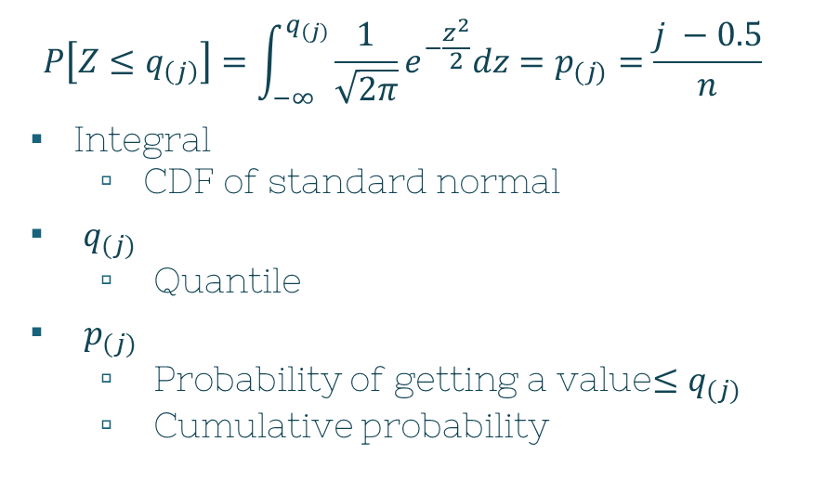
Univariate Evaluation: Histogram
$$π$$
$$\frac{j−0.5}{n}$$
$x_{(j)}$
Sample quantile
Exactly $j ≤x_{(j)}$ when distinct
Proportion $\frac{j}{n}≈\frac{j−0.5}{n}$
$$P\left[Z≤q_{\left(j\right)}\right]=\int_{−∞}^{q_{(j)}}{\frac{1}{\sqrt{2π}}e^{−\frac{z^{2}}{2}}dz=p_{(j)}=\frac{j −0.5}{n}}$$
Integral
CDF of standard normal
$q_{(j)}$
Quantile
$p_{(j)}$
Probability of getting a value$≤q_{(j)}$
Cumulative probability
Notes:
Distinct = theoretically always true when obs are cont
Prop = analytical convenience -> continuity correction

Slide 21

Univariate Evaluation: Histogram
$$π$$
$$P\left[Z≤q_{\left(j\right)}\right]=\int_{−∞}^{q_{(j)}}{\frac{1}{\sqrt{2π}}e^{−\frac{z^{2}}{2}}dz=p_{(j)}=\frac{j −0.5}{n}}$$
Idea:
Look at $(q_{\left(j\right)},x_{(j)})$ with the same $p_{(j)}$
If normal
$\left(q_{\left(j\right)},x_{\left(j\right)}\right)≈$ linearly related
$σ\left(q_{\left(j\right)}\right)+μ\overset{→}{nearly} Ε(x_{\left(j\right)})$
Notes:
Right hand – cumulative probability

Slide 22
Bivariate Evaluation
$$π$$
Normality check
∀ distributions of 2, 3, …, p dims
Visually
Scatterplots for pairs of characteristics
MVN distr ~ elliptical

Slide 23
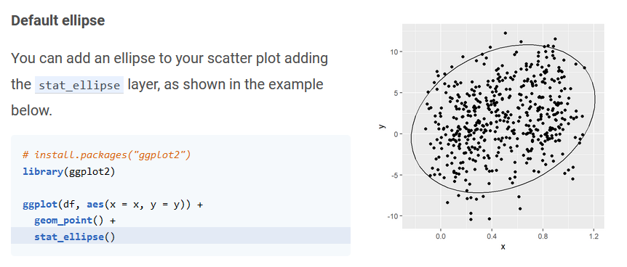
Screenshot from: https://r-charts.com/correlation/scatter-plot-ellipses-ggplot2/

Slide 24
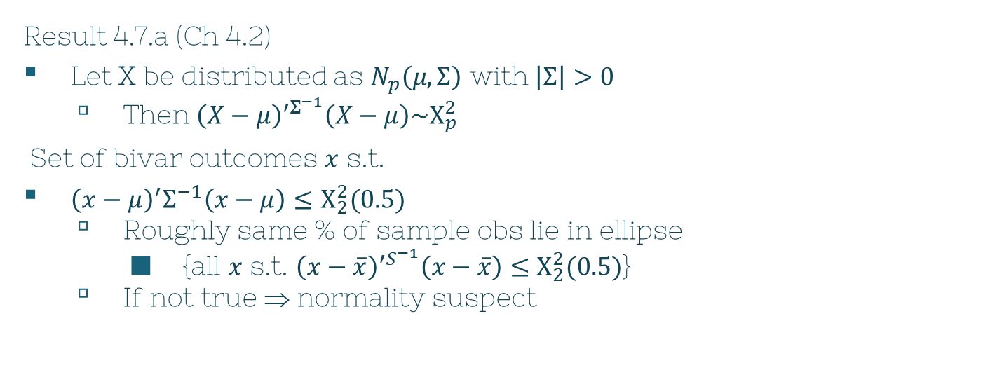

Bivariate Evaluation
$$π$$
Result 4.7.a (Ch 4.2)
Let X be distributed as $N_{p}\left(μ,Σ\right)$ with $\left|Σ\right|>0$
Then ${\left(X−μ\right)}^{′Σ^{−1}}\left(X−μ\right)\sim Χ_{p}^{2}$
Set of bivar outcomes $x$ s.t.
${\left(x−μ\right)}^{′}Σ^{−1}\left(x−μ\right)≤Χ_{2}^{2}(0.5)$
Roughly same % of sample obs lie in ellipse
{all $x$ s.t. ${\left(x−\overline{x}\right)}^{′S^{−1}}\left(x−\overline{x}\right)≤Χ_{2}^{2}(0.5)$}
If not true ⇒ normality suspect
$$↷$$

Slide 25
Detecting Outliers & Cleaning Data
2
Chapter 4, Section 7

Slide 26
Definition
Outlier
An unusual observation that differs from significantly from the others

Slide 27
Heads Up
Not all outliers are wrong numbers!
May justifiably be with the group
May lead to better understanding of the phenomena being studied

Slide 28
Outlier
$$π$$
Single characteristic
Exceedingly large
Immensely small
Multivariate
… complicated

Slide 29
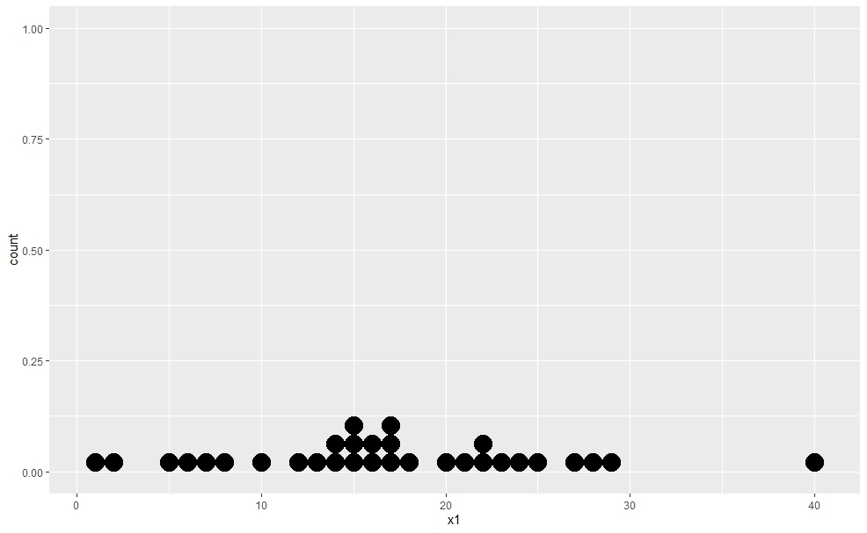
Univariate Example

Slide 30
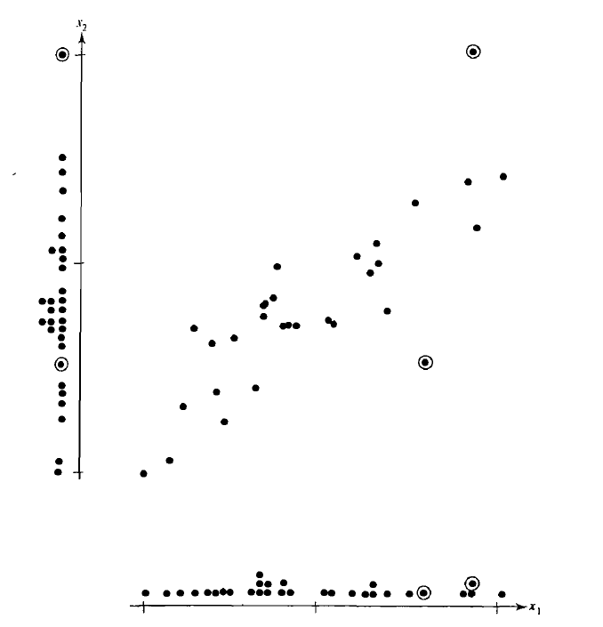
Bivariate Example

Slide 31
Bivariate Example: Marginal Dot Plot of $x_{1}$

Slide 32
Bivariate Example: Marginal Dot Plot of $x_{2}$

Slide 33
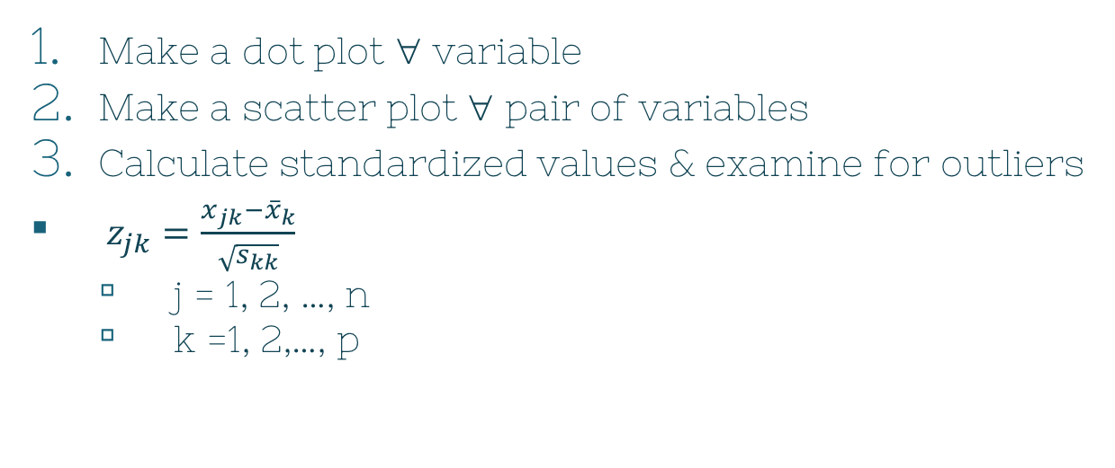
Steps for Detecting Outliers
$$π$$
Make a dot plot ∀ variable
Make a scatter plot ∀ pair of variables
Calculate standardized values & examine for outliers
$z_{jk}=\frac{x_{jk}−{\overline{x}}_{k}}{\sqrt{s_{kk}}}$
j = 1, 2, …, n
k =1, 2,…, p

Slide 34

Steps for Detecting Outliers
$$π$$
4. Calculate generalized squared distance & examine for outliers
${\left(x_{j}−\overline{x}\right)}^{′S^{−1}}\left(x_{j}−\overline{x}\right)$
Note: In $Χ_{p}^{2}$ plot, these points would be farthest from the origin

Slide 35
Transformations to Near Normality
3
Chapter 4, Section 8

Slide 36
What if normality isn’t a viable assumption? What can we do?

Slide 37

Option 1
$$π$$
Ignore the non-normal results
Pretend the data is normally distributed
Proceed with your work
Leads to wrong conclusions
X
So what do we do?

Slide 38
Option 2
$$π$$
Make the non-normal look normal!
Transformations

Slide 39
In Section 4.8, the authors explain that even if the assumption of normality is rejected, we still have the option of transforming the data to make it more "normal-looking." "Normal-theory analyses can then be carried out with the suitably transformed data." They suggest that "power transformations" are often a useful tool for this. Are there situations in practice where a power transformation is a bad idea (leads to misleading results), even if it makes normal-theory analyses possible? Or should we not worry about this?

Slide 40
$$π$$

Slide 41
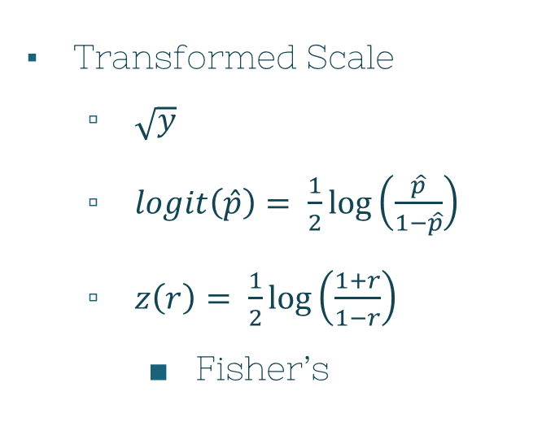

Helpful Transformations to Near Normality
$$π$$
Original Scale
Counts: y
Proportions: $\hat{p}$
Correlations: r
Transformed Scale
$\sqrt{y}$
$logit\left(\hat{p}\right)= \frac{1}{2}\log\left(\frac{\hat{p}}{1−\hat{p}}\right)$
$z\left(r\right)= \frac{1}{2}\log\left(\frac{1+r}{1−r}\right)$
Fisher’s

Slide 42
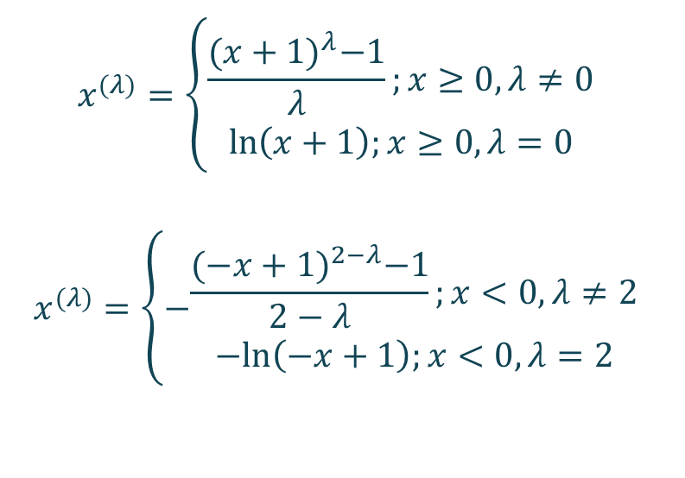
What If…
$$π$$
Data
Large negative values
Single long tail
$$x^{(λ)}=\left\{\begin{aligned}\frac{{(x+1)}^{λ}−1}{λ};x≥0,λ≠0 \\ \ln\left(x+1\right);x≥0, λ=0\end{aligned}\right.$$
$$x^{(λ)}=\left\{−\begin{aligned}\frac{{(−x+1)}^{2−λ}−1}{2−λ};x<0,λ≠2 \\ −ln\left(−x+1\right);x<0, λ=2\end{aligned}\right.$$

Slide 43
Transforming Multivar Obs
$$π$$
∀ variable, a power transformation must be selected

Slide 44
References
Visualizing the Multivariate Normal
http://www2.stat.duke.edu/~rcs46/lectures_2015/02-multivar2/02-multivar2.pdf
Understanding Q-Q plots
https://library.virginia.edu/data/articles/understanding-q-q-plots#:~:text=The%20QQ%20plot%2C%20or%20quantile,as%20a%20normal%20or%20exponential

Slide 45
~Fin~
Any lingering questions?

Slide 46
BIG CONCEPT
Bring the attention of your audience over a key concept using icons or illustrations

Slide 47
And tables to compare data
 | A | B | C
Yellow | 10 | 20 | 7
Blue | 30 | 15 | 10
Orange | 5 | 24 | 16

Slide 48
Our process is easy
first
second
last

Slide 49
Let’s review some concepts
Yellow
Is the color of gold, butter and ripe lemons. In the spectrum of visible light, yellow is found between green and orange.
Blue
Is the colour of the clear sky and the deep sea. It is located between violet and green on the optical spectrum.
Red
Is the color of blood, and because of this it has historically been associated with sacrifice, danger and courage.
Yellow
Is the color of gold, butter and ripe lemons. In the spectrum of visible light, yellow is found between green and orange.
Blue
Is the colour of the clear sky and the deep sea. It is located between violet and green on the optical spectrum.
Red
Is the color of blood, and because of this it has historically been associated with sacrifice, danger and courage.

Slide 50
4000
3000
2000
1000
0
You can insert graphs from Excel or Google Sheets

Slide 51
Timeline
Blue is the colour of the clear sky and the deep sea
Red is the colour of danger and courage
Black is the color of ebony and of outer space
Yellow is the color of gold, butter and ripe lemons
White is the color of milk and fresh snow
Blue is the colour of the clear sky and the deep sea
JAN
FEB
MAR
APR
MAY
JUN
JUL
AUG
SEP
OCT
NOV
DEC
Yellow is the color of gold, butter and ripe lemons
White is the color of milk and fresh snow
Blue is the colour of the clear sky and the deep sea
Red is the colour of danger and courage
Black is the color of ebony and of outer space
Yellow is the color of gold, butter and ripe lemons

Slide 52
SWOT Analysis
STRENGTHS
Blue is the colour of the clear sky and the deep sea
WEAKNESSES
Yellow is the color of gold, butter and ripe lemons
S
W
Black is the color of ebony and of outer space
OPPORTUNITIES
White is the color of milk and fresh snow
THREATS
O
T

Slide 53
Competitor Matrix
HIGH VALUE 2
Competitor
Our company
Competitor
Competitor
LOW VALUE 1
HIGH VALUE 1
Competitor
Competitor
Competitor
LOW VALUE 2

Slide 54
SlidesCarnival icons are editable shapes.
This means that you can:
Resize them without losing quality.
Change line color, width and style.
Isn’t that nice? :)
Examples:

Slide 55
Diagrams and infographics

